Slide 1
Present perfect or Past simple?

Slide 6
What has he done?

Slide 8
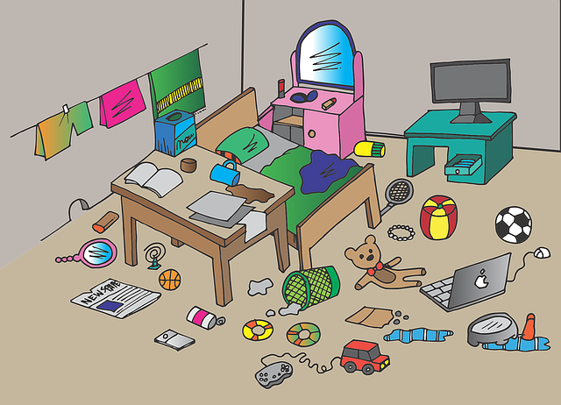
Why is the room such a mess?

Slide 9
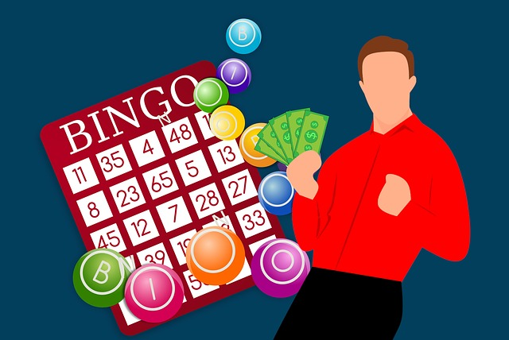
Why is he so happy?

Slide 10
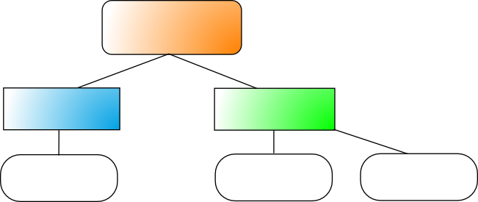
Draw your own graphic organizer

